Slide 1





SMVDU TECH COMMUNITY
SMVDU Hackathon 2022

Slide 2
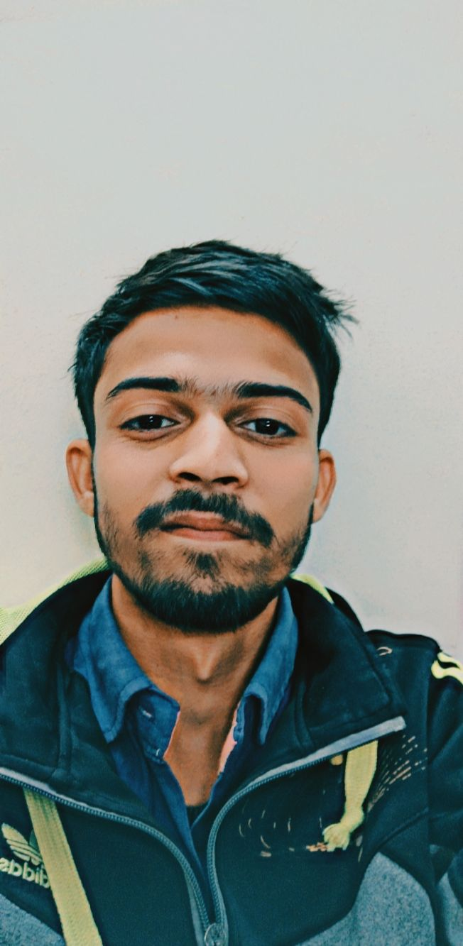
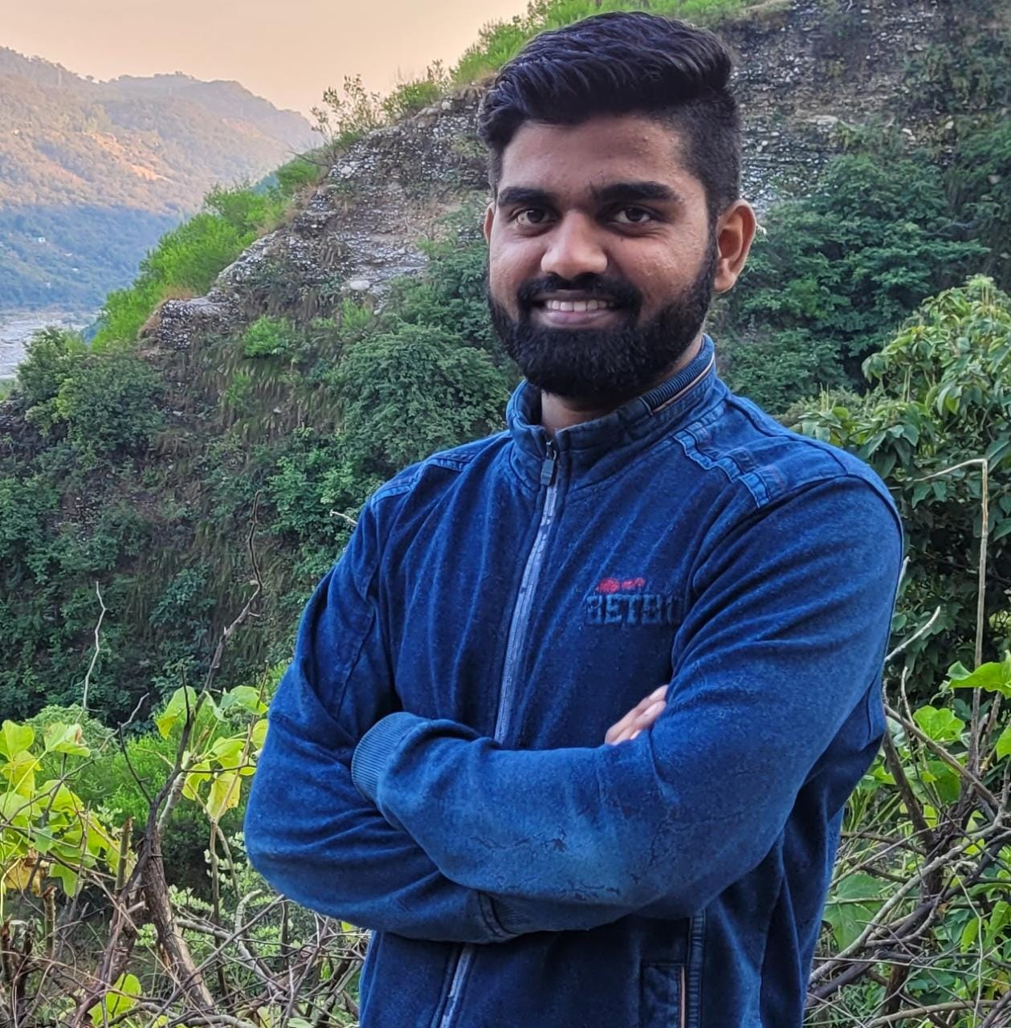
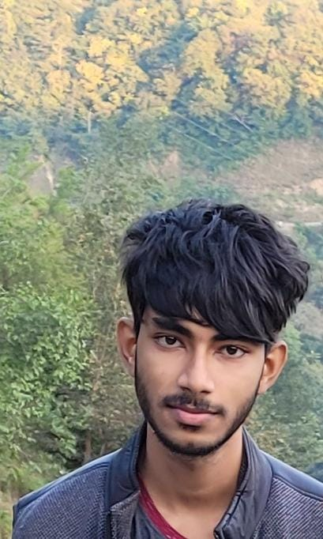
Team details
TEAM NAME: TECHPHILE
Priyanshu Kumar
(Team Leader)
Omkar Kasaudhan
College: SMVDU
Stream: CSE
Year of graduation: 2025
College: SMVDU
Stream: CSE
Year of graduation: 2025
Aryan
Photo
College: SMVDU
Stream: CSE
Year of graduation: 2025
All fields are mandatory

Slide 3
Theme
The theme of our project is to create a food delivery website. Online Food ordering system is a process in which one can order various foods and beverages from some local restaurant and hotels through the use of internet, just by sitting at home or any place. And the order is delivered to the told location.
Our website offers multiple choices based on user driver data and recommends accordingly.

Slide 4
Describe the problem statement (200 words)
With consumers shifting away from the dining-out trend towards home delivery services, technological growth has paced up in the sector. Food delivery services are currently leading the online marketplace. With the evolving market base and future opportunities, many food delivery startups and businesses are entering the market with higher thrust and push, thus making the marketplace competitive and challenging for the firms to capture. A hungry customer can spend on average an hour to decide what to eat! This scenario is especially true for multi-cuisine restaurants. Having so many options to choose from often overwhelm the customers, and many times results in a dropped sale. A recurring problem that customers face when ordering food online is regarding payment. Some restaurant websites do not accept multiple payment method, forcing customers to drop their orders. Security is another factor that people consider when purchasing anything online and if your payment gateway doesn’t assure it, they’ll have no reason to proceed further with their order. Convenience is one reason why more customers than ever before prefer ordering their food online these days. But there are still plenty of websites which have been created without giving any thought to optimizing the user experience.

Slide 5
Proposed solution / your big Idea (200 words)
Helping costumers with user driven data we can provide better recommendations. Using clean and simple UI that is intuitive to use we can provide users a way more intuitive method to select what to order. Less visual clutter also helps to not irritate users trying to order a simple meal. By providing a way for users to make their own profile we can offer them multiple modes of payment and also allow them to save their mode of payment. We have also focused heavily on optimizing the user experience. Our UI also provides the calorie intake to help users better identify their selections according to their diet plans.
Describe TECHNOLOGY USED :

Slide 6
How is your solution different/unique from other solutions in market (150 words)
Our project is build using purely HTML, CSS and Javascript. Since no framework was used our site performs much faster and effeicient as compared to with using frameworks. Also as we explained about UI, its intuitiveness is built upon selecting excellent pictures along with the added information of calories allowing for a more pleasurable experience while surfing the site. Also the added benefit of creating account while ordering allows more payment methods and also allows ease of ordering next time from our site.
PATENT FILED: No
Do you have a working model/prototype: YES
If not, will you be able to show working prototype during finale. YES

Slide 7
Elevator pitch video (1 minute) Share the public link along with the code link
VIDEO LINK :
https://www.instagram.com/reel/ClK-SjHoWQm/?igshid=MDJmNzVkMjY=
CODE LINK:
https://github.com/priyanshu-thakur-2002/Omnifood.git
LINKDEIN LINK:
https://www.linkedin.com/posts/priyanshu-kumar-a06145237_blockchain-web3-activity-6999866351242612736-0oj_?utm_source=share&utm_medium=member_android

Slide 8
Thank you!

